Slide 1
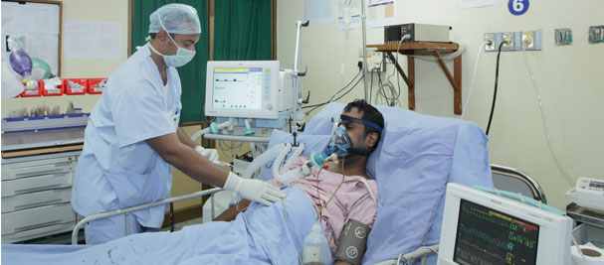
Dignifying Life with Palliative Care

Slide 2
Bangladesh economy growing fast with GDP growth record 7.24pc, per capita income $1,602. Growth 6.4pc to 6.8pc in 2017-18, predicts WB report
3
All these indicators show that Bangladesh economy has been in an upward trend in the last 5 years and this trend is expected to continue over next few years as more investments are being made by both domestic and foreign investors in thrust sectors. http://www.thedailystar.net/business/bangladesh-gross-domestic-product-gdp-growth-record-724pc-capital-income-usd1602-1405051
Source: The World Bank, 2017

Slide 3
Despite the rapid economic growth, people feel they are deprived of minimum healthcare facilities. Bangladesh health care services are termed as inadequate
5
64,434 Doctors
6,034 Dentists
30,516 Nurses
27,000 Midwives
In Bangladesh, health workforce ratio of Doctors to Nurses to Technologists is 1:0.4:0.2
while the WHO recommended ratio is 1:3:5
The National Health Policy 2011 identified Bangladesh as one of the 57 countries in the world suffering from a severe shortage in HWF (Health Work force). Qualified health personnel, like physicians, dentists, nurses and technologists, are insufficient in number, particularly in hard to reach rural areas. According to a WHO estimate, Bangladesh has a shortage of more than 60,000 doctors, 280,000 nurses and 483,000 technologists. Bangladesh also does not fare well compared to neighboring countries in terms of distribution of HWF across populations (Table 10.2). http://www.plancomm.gov.bd/wp-content/uploads/2015/11/7FYP_after-NEC_11_11_2015.pdf
Source: Bangladesh Medical Association (2016-17), Bangladesh Health System Review (2015)

Slide 4
Healthcare Sector is Neglected in Bangladesh
6
Total Healthcare Expenditure is merely 3.7% of a GDP of USD 221 bn. Allocation for healthcare sector in total ADP is only 6.2% for FY 2017-18
Only 32 USD per Capita Healthcare Expenditure compared to India 75, China 420, USA 9,403 and UK 3,935 USD
Economic Intelligence Unit of The Economist has ranked 80 countries on the quality of healthcare facilities available. In that index, Bangladesh has ranked
79th on the Quality of Death Index
80th on the Quality of Care Index
80th on the Quality of Health Workforce Index
Source: MoF, WHO, The Economist, The World Bank, 2017

Slide 5
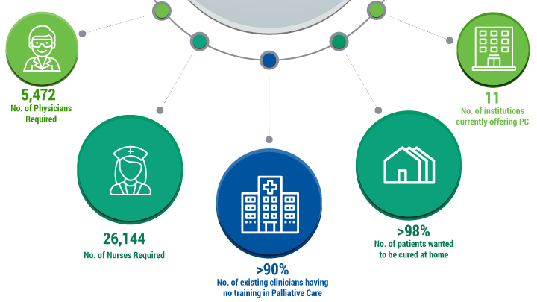
Palliative Care in Bangladesh at A Glance
8
+
+
Source: Bangladesh Medical Association, 2016-17

Slide 6
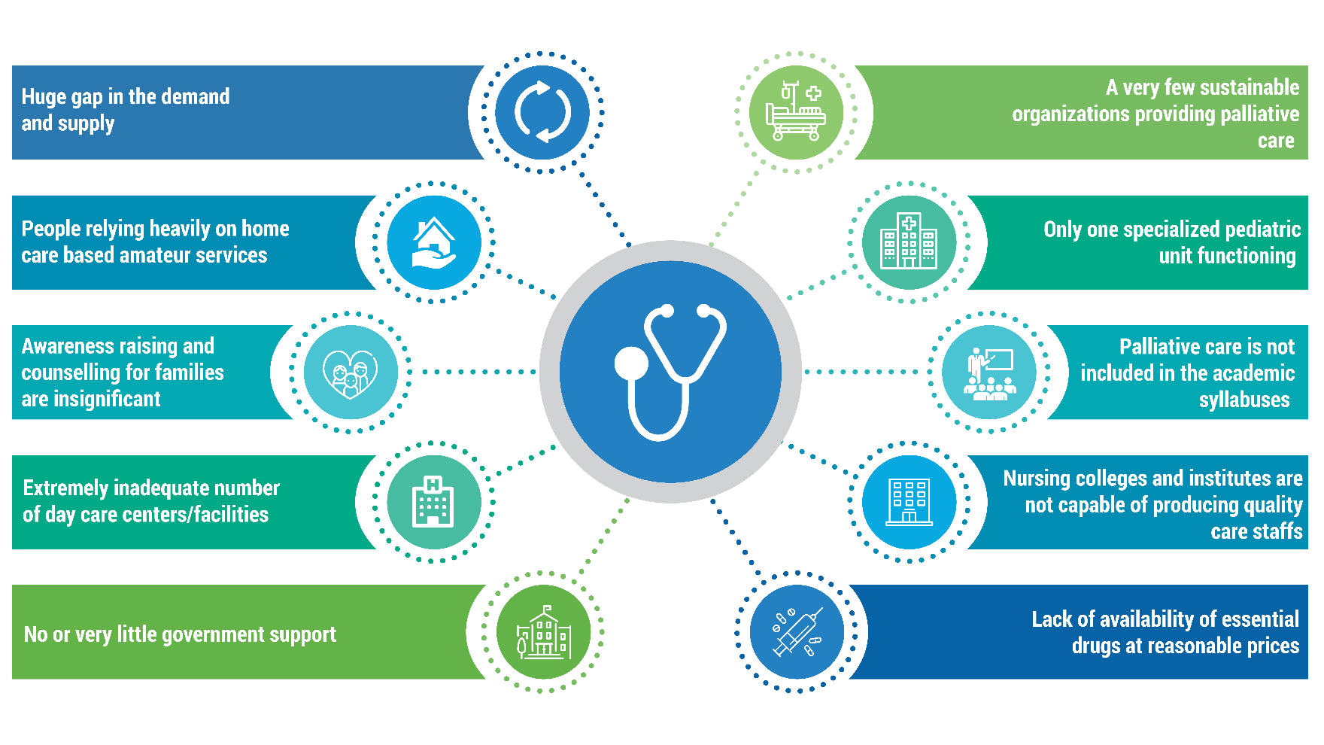
Lack of Infrastructure, Shortage of Health Workforce dominating Palliative Care Supply Side Dynamics
9
Source: LightCastle Primary Research Findings, 2016-17

Slide 7
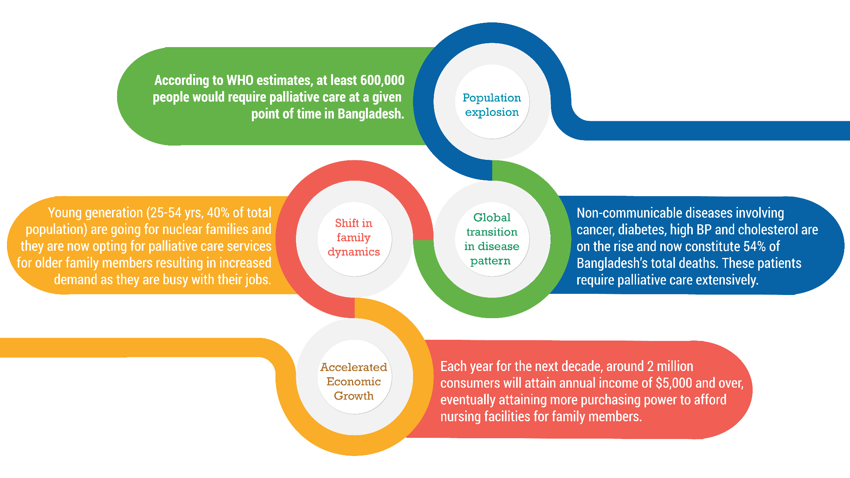
Demand of Palliative Care is Ever-rising
11
By 2030, 20% of the total population will be over 60+ years of age
By 2030, country’s MAC population (minimum monthly HH income is USD 450) will exceed 38 mn
Source: BCG, Bangladesh Medical Association, 2016-17

Slide 8
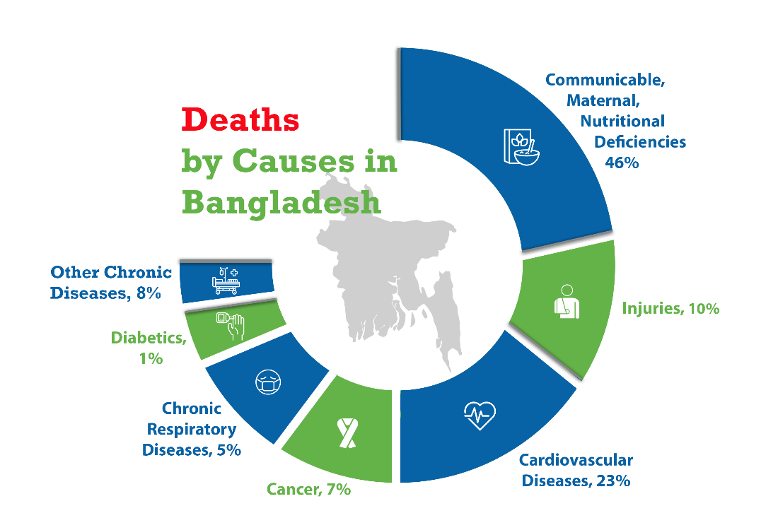
A Deep Dive into the Causes of Death stresses the Necessity of Palliative Care Facilities in Bangladesh
12
There’s a sharp increase in death tolls due to non-communicable diseases
According to WHO, ~600,000 patients would require palliative care and support annually in Bangladesh
Besides, with at least 2 family members involved in each of these patients’ care, a globally homogenous development of palliative care could improve the quality of life of ~1,200,000 people nationwide, annually.
54%
Source: Bangladesh Medical Association, 2016-17

Slide 9
Increasing Numbers of Patients suffering from Life-limiting Major Non-communicable Diseases also Strengthens this Fact
13
~200,000 patients are newly diagnosed with cancer each year of which, 80-90% are in incurable state
~40,000 people die each year from chronic kidney diseases while ~30,000 more patients suffer from acute kidney failure – all requiring palliative care along with the regular treatments
Every year, ~300,000 new patients are diagnosed with TB among whom, ~70,000 people die each year.
According to WHO, there are ~8,000 people living with HIV
Among the ~12 million older people (aged over 60), a few thousands may be suffering from some form of dementia
Source: Bangladesh Medical Association, 2016-17

Slide 10
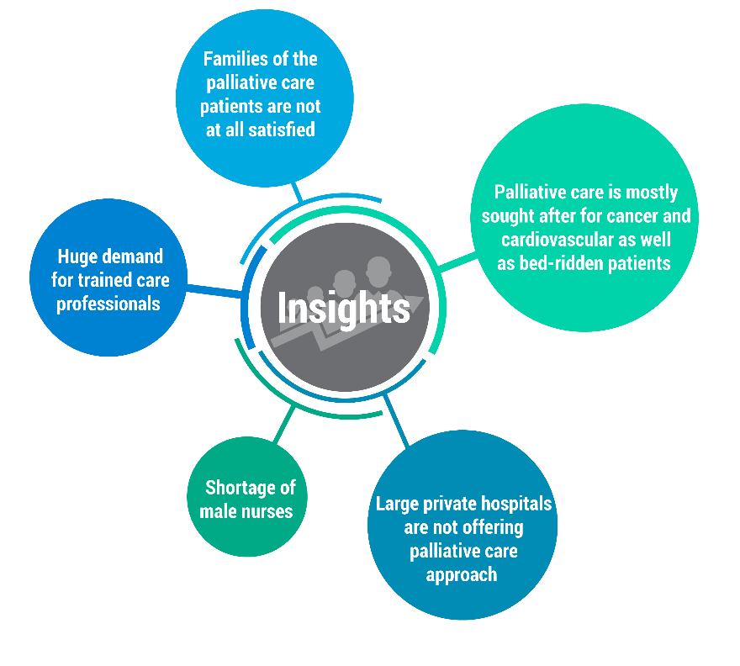
Let’s Hear it from the Patients/FnF
14
Case Study 1:
Mrs. Alvira Begum, aged 78, lost her husband 20 years ago, lives with her only son and his second wife who are extremely busy with their own lives. She has faced a chronic pneumonia attack quite recently – but there was nobody to take care of her, except for the maid. She has been suffering from bed sores and some other critical injuries due to lack of movement and proper care. She knows she’s going to die but she wants to die with dignity.
Case Study 2:
7 years old Nishat has been diagnosed with Leukemia. She has been in the care center for the last 2 months. She misses her home a lot but she has found new friends here as well. She plays with them whenever she can. Nishat has made many wonderful friends and caring nurses here who often made her smile with funny stories and nice gifts.
Source: LightCastle Primary Research, 2016-17

Slide 11
The Competitive Landscape – who is doing what in Palliative Care
16
Care Giving Facility
Govt.
Private
Palliative Care Society of Bangladesh
Momotamoyee Sonargaon
Oncology Depts of Apollo, Square and United Hospitals
Sajida Foundation
Hospice Bangladesh
ASHIC Foundation
DMC
BSMMU
Bangladesh Palliative Care Services
Children’s Palliative Care Initiative Bangladesh
General Care
Palliative Care
Grameen Caledonian College of Nursing
Holy Family Red Crescent Nursing College
BSMMU
Untapped
Bangladesh Nursing and Midwifery Council
Other Nursing Colleges and Institutes
Capacity Building Facility
Source: LightCastle Primary Research, 2016-17

Slide 12
Coordination and Collaboration among Govt., Donors, NGOs, Private Sector will be the Key solution
18
Palliative care to be included in the national health plan, policies and related regulations
Awareness raising among the policy makers, regulators and make a connection with NGOs in order to culminate coordinated efforts
Incorporation of Palliative care as a separate discipline to be made in the national curriculum of nursing colleges and healthcare institutions
Allocate more budget for public health
Establish new nursing colleges and institutes
Hospitals to build own knowledge centers
Private sector to come up with sustainable business models
Shift of focus from urban to rural areas
Incorporation of changes in policies to accommodate import and distribution of essential drugs
Capacity building in order to train healthcare professionals on appropriate use of these drugs
Source: LightCastle Primary Research, 2017

Slide 13
WHO Model
20
Policy
Advocacy
Capacity Building
Essential Medicines
Coordination &
Collaboration

Slide 14
National Policy Emphasizing Capacity Building, Meds Availability, Curriculum Modernization
Clause 12 of principles of healthcare policy
Clause 3 of specific purpose of national healthcare policy
Clause 13 of major objectives and goals of healthcare policy
Capacity building of health workforce i.e., doctors, nurses, technologists and other staffs
to encourage the citizens to avail all required healthcare services
to modernize and improve the healthcare curriculum and education system in the field of nursing and medical technologies
Clause 15, 25 of strategic approaches of healthcare policy
Clause 1 of major objectives and goals of healthcare policy
Clause 17 of major objectives and goals of healthcare policy
to modernize and restructure existing capacity building institutions and establishment new ones
to ensure healthcare facilities for all as a human right
to ensure availability of essential medicines and control pricing

Slide 15
SDG 3 Emphasizing Healthy Lives and Promotion of Well-being for All at All Ages – Particularly in making Essential Meds Available for all and Health Workforce Capacity Development
3.8
Access to quality essential healthcare services and access to safe, effective, quality and affordable essential medicines and vaccines for all.
3.C
Substantially increase recruitment, development, training and retention of the health workforce in developing countries

Slide 16
The solution in hand
Alignment of the Bangladesh National Health Policy, 2011
with the
Sustainable Development Goal 3
Inclusion in the Five Year Plan
Allocation of fund in Annual Budget
Integrated Quality Health Services
Public and Private Sector Collaboration
Capacity Building and Public Awareness

Slide 17
THANK YOU!

